Slide 1
Alpa
Automated Inter- and Intra-Operator Parallelism for Distributed Deep Learning
Presenter: Insu Jang
Slides are borrowed or reconstructed from original ones

Slide 2
Models are Becoming Larger
Switch Transformer
3,120GB
Need to partition model!
Megatron- Turing NLG
1,060GB
Turing-NLG
34GB
GPT-3
350GB
NVIDIA H100: 80GB
Intel Gaudi2: 96GB
AMD MI300: 128GB
BERT
0.7GB
GPT-2
3GB
Megatron-LM
17GB
Notes:
Today’s model is getting larger and larger for higher accuracy, and now single GPU cannot even just hold model parameters in its memory.
This leads to partitioning the model and distributing parameters to multiple GPUs.

Slide 3
Review: Parallelism in Megatron-LM
Distribute computation
Distribute data
Distribute model
Data Parallelism | Tensor Parallelism | Pipeline Parallelism
GPU 1
GPU 1
GPU 1
GPU 2
Minibatch
Batch
Batch
GPU 2
GPU 2
Minibatch
Notes:
I believe you studied parallelism when discuss Megatron-LM last week.
Megatron-LM introduces 3D parallelism, a combination of data parallelism, tensor model parallelism, and pipeline parallelism.
Data parallelism distributes input dataset into multiple minibatch and distribute them with replicated model, while model parallelism partitions model parameters and distribute them to multiple GPUs.

Slide 4
Review: Parallelism in Megatron-LM
Distribute computation
Distribute data
Distribute model
Data Parallelism | Intra-OP Parallelism | Inter-OP Parallelism
GPU 1
GPU 1
GPU 1
GPU 2
Minibatch
Batch
Batch
GPU 2
GPU 2
Minibatch
Notes:
Although Megatron-LM call those parallelisms as tensor parallelism and pipeline parallelism, we can also

Slide 5
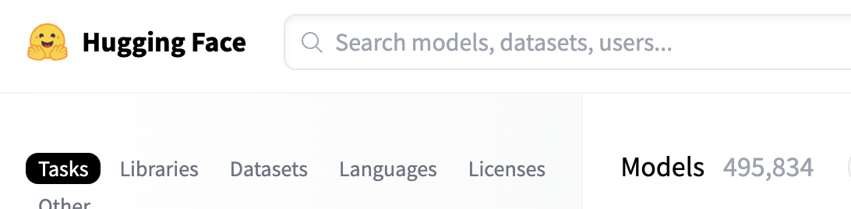
Problem
How to automatically parallelize arbitrary models?
Notes:
Megatron-LM did well to partition GPT models, but now we have tons of models out there. To utilize Megatron-LM’s parallel execution, a model needs to be carefully partitioned and parallelized manually, which is very hard to achieve.
How we can automatically parallelize any model?

Slide 6
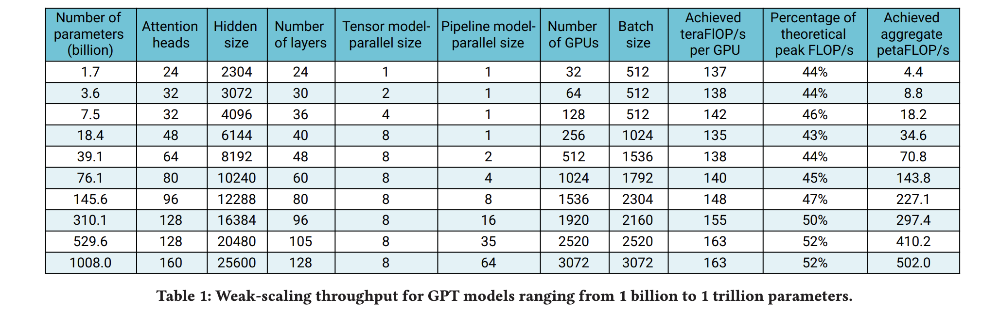
Problem
How to automatically parallelize arbitrary models?
How to partition model and cluster to provide maximum throughput?
Notes:
At the same time, automatic parallelization should not sacrifice the throughput, and needs to find the best partitions after exploring all search space.
This is not achievable in manual partitioning system like Megatron-LM. Table 1 is from Megatron-LM paper, which uses static 64 pipeline stages for 1 trillion model parameter with 3000 GPUs. Are they sure that this partitioning is the best? We can’t say.

Slide 7
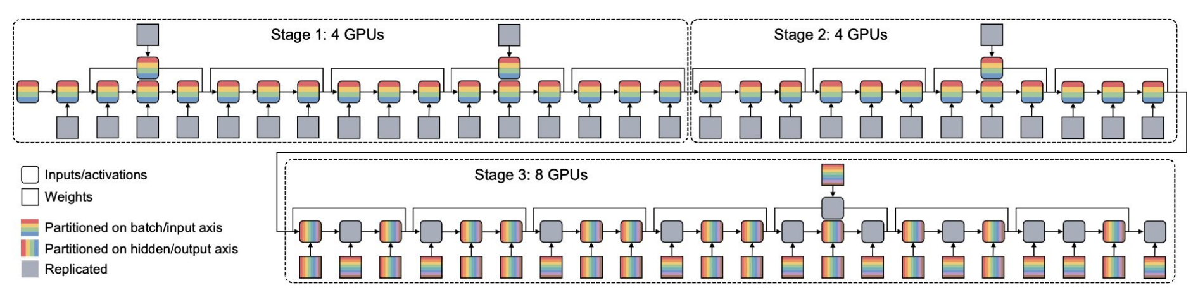
Problem
How to automatically parallelize arbitrary models?
How to partition model and cluster to provide maximum throughput?
Wide-Resnet with Alpa and 16 GPUs
Notes:
Also, Megatron-LM cannot support heterogeneous GPU assignment to different pipeline stages.

Slide 8
Observation
Different parallelizations have different bandwidth characteristics
Today’s compute cluster has heterogeneous network topology
Intra-OP Parallelism
Inter-OP Parallelism
High amount of communication
Low amount of communication
Slow
Node
Node
Node
Node
GPU
GPU
GPU
GPU
Fast
GPU
GPU
GPU
GPU
GPU
GPU
GPU
GPU
GPU
GPU
GPU
GPU
Notes:
They found two observations and designed Alpa.
First, they found different model parallelism has different network bandwidth requirements. Intra-OP requires substantial communication, while inter-OP only has communication at the boundary of stages, thus has less communication burden.
Second,

Slide 9
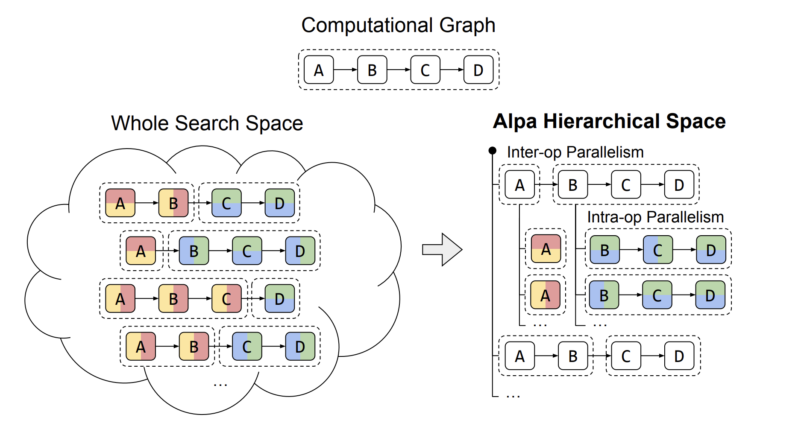
Alpa
Generate execution plans using hierarchical optimization algorithm
Match parallelism hierarchy with device topology hierarchy
Notes:
So, they break down finding an optimal configuration into two parts, and hierarchically solve them to get one, to reduce search space and formulate the equation.

Slide 10
Hierarchical Plan Generation
GPU
GPU
GPU
GPU
GPU
GPU
GPU
GPU
GPU
GPU
GPU
GPU
Computational Graph
Device Cluster
Inter-OP Pass
Partition computational graph and device cluster and map them to stages Search all combination of stages and fine the best configuration
Invoke to get cost of each stage
Intra-OP Pass
For each pipeline stage given operations and # devices, compute best intra-OP parallel configuration
Notes:
The hierarchical plan generation is done in two passes. First, it partitions the model and device cluster at the same time in inter-OP pass, creating pipeline stages.
It first goes through inter-OP parallelism pass. Inter-OP pass partitions the model computational graph and device cluster, and map them to create pipeline stages.
For each pipeline stage, it invokes intra-OP pass to get execution time, and use this information to estimate overall pipeline execution time.
Because inter-OP pass and intra-OP pass both consider network bandwidth, what they find is a configuration plan that actually minimizes iteration time considering current network topology and performance.

Slide 11
Hierarchical Plan Generation
GPU
GPU
GPU
k1
k2
w1
w2
GPU
GPU
GPU
GPU
GPU
GPU
x
conv
relu
conv
add
avgpool
matmul
relu
matmul
softmax
GPU
GPU
GPU
* One example of partitioning
Stage 1
k1
k2
w1
w2
x
conv
relu
conv
add
avgpool
matmul
relu
matmul
softmax
GPU
GPU
GPU
GPU
GPU
GPU
GPU
GPU
GPU
GPU
GPU
GPU
1. Partition model computation graph and device cluster to create a stage

Slide 12
Hierarchical Plan Generation
GPU
GPU
GPU
k1
k2
w1
w2
GPU
GPU
GPU
GPU
GPU
GPU
x
conv
relu
conv
add
avgpool
matmul
relu
matmul
softmax
GPU
GPU
GPU
* One example of partitioning
k1
k2
GPU
GPU
x
conv
relu
conv
add
GPU
GPU
Single stage
Submesh
k1
k2
x
conv
relu
conv
add
2. Invoke Intra-OP pass that minimizes computation cost of a single stage

Slide 13
Hierarchical Plan Generation
GPU
GPU
GPU
k1
k2
w1
w2
GPU
GPU
GPU
GPU
GPU
GPU
x
conv
relu
conv
add
avgpool
matmul
relu
matmul
softmax
GPU
GPU
GPU
* One example of partitioning
Stage 1
k1
k2
w1
w2
x
conv
relu
conv
add
avgpool
matmul
relu
matmul
softmax
GPU
GPU
GPU
GPU
GPU
GPU
GPU
GPU
GPU
GPU
GPU
GPU
1. Partition model computation graph and device cluster to create a stage

Slide 14
Hierarchical Plan Generation
GPU
GPU
GPU
k1
k2
w1
w2
GPU
GPU
GPU
GPU
GPU
GPU
x
conv
relu
conv
add
avgpool
matmul
relu
matmul
softmax
GPU
GPU
GPU
* One example of partitioning
Stage 1
Stage 2
Stage 3
k1
k2
w1
w2
x
conv
relu
conv
add
avgpool
matmul
relu
matmul
softmax
GPU
GPU
GPU
GPU
GPU
GPU
GPU
GPU
GPU
GPU
GPU
GPU
3. Add more pipeline stages to cover more graph and devices Keep finding minimum iteration time using dynamic programming

Slide 15
Hierarchical Plan Generation
GPU
GPU
GPU
k1
k2
w1
w2
GPU
GPU
GPU
GPU
GPU
GPU
x
conv
relu
conv
add
avgpool
matmul
relu
matmul
softmax
GPU
GPU
GPU
* One example of partitioning
Stage 1
Stage 2
Stage 3
k1
k2
w1
w2
x
conv
relu
conv
add
avgpool
matmul
relu
matmul
softmax
GPU
GPU
GPU
GPU
GPU
GPU
GPU
GPU
GPU
GPU
GPU
GPU
3. Add more pipeline stages to cover more graph and devices Keep finding minimum iteration time using dynamic programming

Slide 16
Evaluation
Setup
Measure throughput of weak-scaled GPT3 (model grows together with more GPUs)
8 AWS EC2 p3.16xlarge (8 16GB V100s each, 64 GPUs total)
Compare Alpa and Megatron-LM (SOTA manual partitioning)
Questions
Is Alpa’s plan as good as manual systems (e.g. Megatron-LM)?
Is Alpa’s hybrid parallelization better than single-type parallelization (e.g. intra-OP only)?

Slide 17
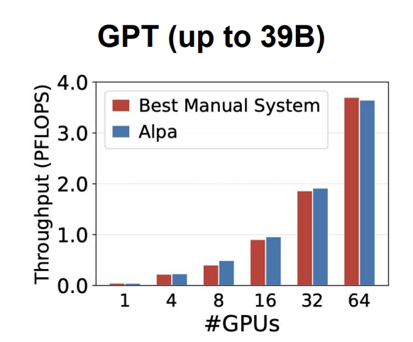
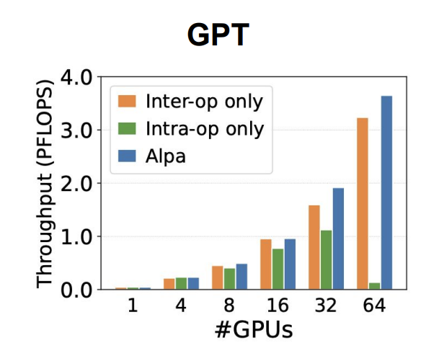
Evaluation
Matches specialized manual partitioning system (Megatron-LM)
Combining inter- and intra-OP parallelism scales to more GPUs

Slide 18
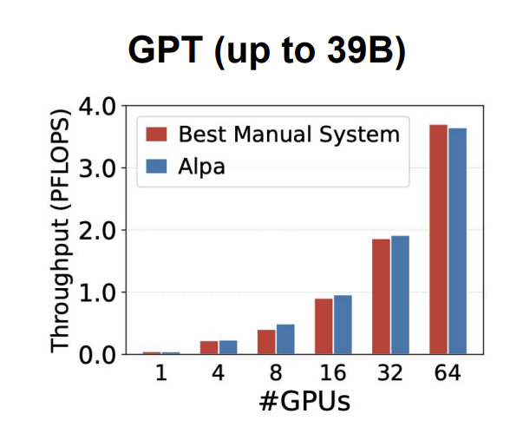
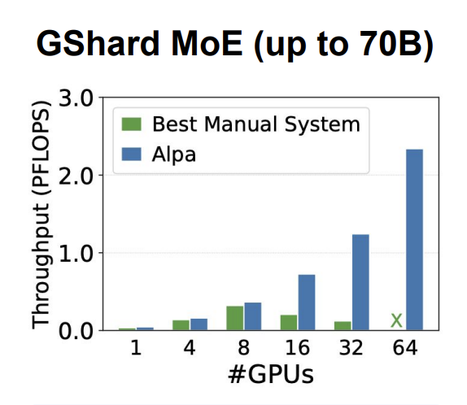
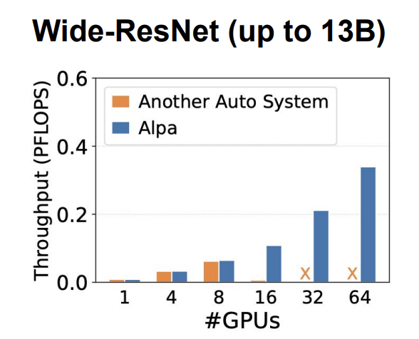
Evaluation – Other Models
Megatron-LM with 3D parallelism
ZeRO data parallelism + handcrafted MoE parallelism
Only consider PP+DP (no intra-OP or TP)

Slide 19
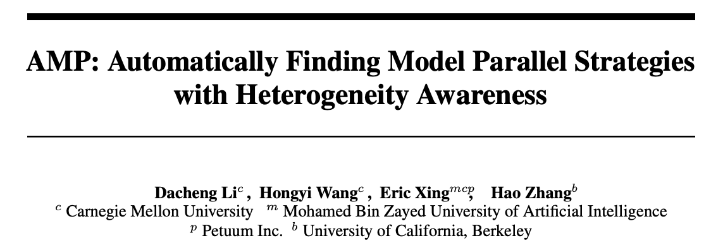
Discussion
Alpa supporting heterogeneous GPUs/networks?
Way to implement Alpa for non-JAX?
Must be able to represent tensors in intermediate representation (IR), manipulate them, and compile them for execution
Recently PyTorch also introduces torch.compile → may be possible
OpenAI introduces Triton compiler → its purpose is not for parallelization, but maybe
AMP in NeurIPS’22
“This motivates the core questions in this paper: Is it possible to automatically find the best model-parallel strategies for more heterogeneous models and clusters?"
Alpa authors

Slide 20
Oobleck
Resilient Distributed Training of Large Models Using Pipeline Templates
Insu Jang, Zhenning Yang, Zhen Zhang, Xin Jin, and Mosharaf Chowdhury
Notes:
0:15

Slide 21
Large Model Training Models are Becoming Larger
Switch Transformer
3,120GB
Megatron- Turing NLG
1,060GB
Turing-NLG
34GB
GPT-3
350GB
NVIDIA H100: 80GB
Intel Gaudi2: 96GB
AMD MI300: 128GB
BERT
0.7GB
GPT-2
3GB
Megatron-LM
17GB
Assumes 2 bytes per parameter.
Notes:
Today’s models are getting larger and larger, so even a single latest GPU cannot store all model parameters in its memory.
0:30

Slide 22
Large Model Training Failures Getting Noticeable
Higher probability of GPU failing
We use more GPUs, each of which can fail independently
Higher cost of GPU failing
The entire training must pause, wasting all working GPUs due to synchronization
More GPUs are used
Reports about the impact of failures in training large models
Meta AI training OPT: “Estimated 100+ host restarts due to hardware failures over the course of 2 months.” ^{[1]}
LAION training CLIP models: “Hardware issue is an annoying problem as if one GPU has an issue, all GPUs get stuck.” ^{[2]}
[1] Susan Zhang et al. “OPT: Open Pre-trained Transformer Language Models”. Arxiv’22
[2] Romain Beaumont, “Large Scale OpenCLIP: L/14, H/14 and G/14 Trained on LAION-2B”. https://laion.ai/blog/large-openclip/
Notes:
While Gemini introduced why fault tolerance is important very well, but I would like to retierate it.
Hybrid parallelism enables to use hundreds or thousands of GPUs for a single job, this raises a traditional problem of distributed execution back to surface, fault tolerance.
The More GPUs are used, the higher probability of failures and cost of each failures are at the same time, thus overheads from failures are getting noticable.
This is even worse in distributed training, because all devices must be synchronized for every iteration, meaning just one failure could make the entire job stuck.
(CLICK) some reports from industry like Meta or LAION, complained that the impact of failures were not ignorable.
1:40

Slide 23

Background: Checkpoint
Naive solution for fault tolerance is checkpointing
Checkpoint itself has overheads + additional fallback overheads
iteration n
...
iteration n+k
Checkpoint
iteration n+k+1
Store intermediate result into persistent storage
Progress lost
Failure!
Checkpoint
iteration n+k+1
iteration n+k+2
iteration n+k+3
Restart from the last checkpoint
Notes:
To handle failures, checkpointing has long been used as a naive solution. It periodically stores intermediate progress into persistent storage.
When a failure happen, we can simply restart from the last checkpoint by reconfiguration. But all progresses made after the checkpoint will be lost.
But checkpointing is not actually a fault tolerance work.

Slide 24



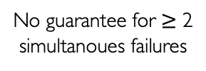
Resilient Training Requirements
Bamboo ^{[1]}
Varuna ^{[2]}
Oobleck (ours)
Guaranteed fault tolerance
No guarantee for $≥$ 2 simultanoues failures
No formal fault tolerance guarantee
High throughput
Pre-generate all viable execution plans
High computational overheads
Getting slower when recovery overheads are higher
Fast recovery
Dynamic reconfiguration without restart
Full restart from the last checkpoint
[1] John Thorpe et al. “Bamboo: Making Preemptible Instances Resilient for Affordable Training of Large DNNs”. NSDI’23
[2] Sanjith Athlur et al. “Varuna: Scalable, Low-cost Training of Massive Deep Learning Models”. EuroSys’22
Notes:
To support fault tolerance, some works have been proposed recently.
(CLICK) Bamboo provides redundancy by redundantly computing same iteration twice but in different GPUs. It successfully avoids full restart when a failure happens, but redundant computation slows down its throughput drastically. Worse, there is no fault tolerance guarantee and whether it can recover from failures depends on the location of failures.
(CLICK) Varuna proposes pre-generating all viable execution plans so that when failures happen it can quickly switch to a new plan. As there is no computational overheads, it is generally fast.
Still, it needs to fully restart by terminating and relaunching all processes, loading the last checkpoint, thus its recovery is slow.
This slow recovery actually affects throughput. (CLICK) Varuna is getting slower when failure happens more frequently, or loading checkpoint takes longer becuase of the model size, and so on.
(CLICK) Oobleck is designed to satisfy all three requirements!
Although Oobleck can be backup by using checkpointing together, if you can assure that failures happen within the guaranteed range, Oobleck doesn’t even need checkpointing at all.
3:00

Slide 25
Oobleck: Overview
Hybrid parallelism has multiple replicas of a model
Utilize inherent redundancy in hybrid parallel execution
Introducing pipeline template
Oobleck’s core idea to achieve both high throughput and fast recovery simultanouesly
A specification of pipeline execution
Guaranteed fault tolerance
high throughput
fast recovery
Notes:
Oobleck is inpspired by the fact that hybrid parallel training already has inherent redundancy so weuse it for guaranteed fault tolerance.
To achieve high throughput and fast recovery, we introduce pipeline template.
3:20

Slide 26
Fault Tolerance Guarantee
Utilize inherent redundancy in hybrid parallel execution
Pipeline Replica 1
1
2
3
4
5
6
7
8
9
10
11
12
Stage 1
Stage 2
Stage 3
Stage 4
Pipeline Replica 2
1
2
3
4
5
6
7
8
9
10
11
12
Stage 1
Stage 2
Stage 3
5
6
7
7
8
1
2
3
4
5
6
7
8
9
Pipeline Replica 3
8
9
10
11
12
Stage 1
Stage 2
Notes:
From the previous example of hybrid parallel execution, there are three pipeline replicas, which means we can tolerate (CLICK) up to 2 pipeline failures even in the worst case.
(CLICK) We still have the model states across the node, (CLICK) we can copy them to restore the lost model states.
Oobleck provides configurability here, so that if users need guarantee to tolerate more failures, Oobleck increases the number of replicas so that it can tolerate more simultanoues failures.
Theoratically if you can specify the hard upper bound of the number of simultanoues failures in your cluster, Oobleck doesn’t even need a single checkpoint during training.
I saw some question here,
4:00

Slide 27
Pipeline Template
Each template is a pre-generated single pipeline execution specification for specific number of nodes
Node
Node
Node
GPU
GPU
GPU
GPUs in 3 nodes
GPU
GPU
GPU
1
2
3
4
5
6
7
8
9
10
11
12
A model
Notes:
Now I am going to introduce the core concept of Oobleck, pipeline template.
Oobleck introduces the concept of template for distributed training for the first time.
A single pipeline template is a specification of a single pipeline execution of a model given specific number of nodes.
(CLICK) we analyze which way of partitioning GPUs and model layers would provide the best throughput (CLICK)

Slide 28
Pipeline Template
Each template is a pre-generated single pipeline execution specification for specific number of nodes
GPU
GPU
GPU
GPU
GPU
GPU
1
2
3
4
5
6
7
8
9
10
11
12
Stage 1
Stage 2
Stage 3
Stage 4
A Pipeline Template for 3 Nodes
Notes:
And map each pair to create pipeline stages to form a pipeline.
After generating the specification, it is used again and again to instantiate pipelines for training.
4:40

Slide 29
Pipeline Template Parallel Execution Configuration
Parallel execution plan is configured as a linear combination of templates
Use all nodes & reduce search space but provide high throughput
...
...
Pipeline Template for 2 Nodes
Pipeline Template for 3 Nodes
Pipeline Template for 4 Nodes
Pipeline Template for k Nodes
An example of parallel execution plan with 13 nodes
1x pipeline from the pipeline template for 2 nodes
1x pipeline from the pipeline template for 3 nodes
2x pipelines from the pipeline template for 4 nodes
Notes:
Oobleck creates multiple heterogeneous pipeline templates, each of which has different number of nodes specified.
Parallel execution plan is made as a linear combination of pipeline templates.
(CLICK) As an example, parallel execution with 13 nodes can be configured as a linear combination of 3 different pipeline templates
This way of configuration has two advantages. (CLICK)
First, it is available to use all available nodes even if the number of nodes does not form a grid. 13 nodes is a prime number but linearly combining different pipeline templates can cover all 13 nodes.
More importantly, it drastically reduces search space to find the best parallel execution plan. Considering such heterogeneous pipeline configuration, search space is enormously large, while linear combination of predefined pipeline templates is countable.
5:50

Slide 30
Pipeline Template Failure Recovery
Quickly reinstantiate a new pipeline from a template when failures happen
...
...
Pipeline Template for 2 Nodes
Pipeline Template for 3 Nodes
Pipeline Template for 4 Nodes
Pipeline Template for k Nodes
GPU
GPU
GPU
GPU
GPU
GPU
GPU
GPU
1
2
3
4
5
6
7
8
9
10
11
12
Stage 1
Stage 2
Stage 3
Stage 4
A pipeline instantiated from the template for 4 nodes
Notes:
When failures happen, Oobleck can provide fast recovery by simply reinstantiating another pipeline template.
Here we have a pipeline instantiated from the pipeline template for 4 nodes.

Slide 31
Pipeline Template Failure Recovery
Quickly reinstantiate a new pipeline from a template when failures happen
...
...
Pipeline Template for 2 Nodes
Pipeline Template for 3 Nodes
Pipeline Template for 4 Nodes
Pipeline Template for k Nodes
GPU
GPU
GPU
GPU
GPU
GPU
1
2
3
7
8
9
10
11
12
Stage 1
Stage 3
Stage 4
A node fails and GPUs are lost
Notes:
After a node fails, we now have 3 nodes.
(CLICK) As we have a pipeline template for 3 nodes, (CLICK)

Slide 32
Pipeline Template Failure Recovery
Quickly reinstantiate a new pipeline from a template when failures happen
...
...
Pipeline Template for 2 Nodes
Pipeline Template for 3 Nodes
Pipeline Template for 4 Nodes
Pipeline Template for k Nodes
GPU
GPU
GPU
GPU
GPU
GPU
n
Layers that GPUs have
Layers that GPUs don’t have
1
2
3
4
5
6
7
8
9
10
11
12
n
Stage 1
Stage 2
Stage 3
Stage 4
Instantiate a pipeline template for 3 nodes
Notes:
we can simply reinstantiate a new pipeline from the pipeline template for 3 nodes.
Of course, after reinstantiation, some nodes still do not have some model layers, indicated as red boxes in the screen.

Slide 33
Pipeline Template Failure Recovery
Quickly reinstantiate a new pipeline from a template when failures happen
...
...
Pipeline Template for 2 Nodes
Pipeline Template for 3 Nodes
Pipeline Template for 4 Nodes
Pipeline Template for k Nodes
GPU
GPU
GPU
GPU
GPU
GPU
Layers that GPUs have
Another pipeline replica
n
1
2
3
4
4
5
5
6
6
7
8
9
Layers that GPUs don’t have
9
10
11
12
GPU
GPU
GPU
GPU
n
Stage 1
Stage 2
Stage 3
Stage 4
GPU
GPU
GPU
GPU
1
2
3
4
5
6
7
8
9
10
11
12
Copy missing layers from replica(s)
Stage 1
Stage 2
Stage 3
Stage 4
Notes:
We have other replicas, thus copy missing layers from them.
Now this pipeline can resume training.
Thanks to the pipeline templates which are pre-generated before, changing pipeline configuration can be done instantly.
6:45

Slide 34
Issues in Using Pipeline Templates
Determining # pipeline templates and # nodes for each template
→ Node Specification
Determining number of pipelines to be instantiated from each template
→ Pipeline Instantiation
What if there is no feasible pipeline template to be instantiated?
→ Pipeline Merge
Notes:
Just using pipeline templates is not enough for high throughput and fast fault tolerance.
Let’s see what more should be addressed.
(CLICK) first, we need to determine the number of pipeline templates and their number of nodes specification.
This is crucial for using all available nodes.
(CLICK) second, we need to determine how many actual pipelines should be instantiated from each pipeline template.
(CLICK) third, we briefly introduced pipeline reinstantiation in a failure case, but there might not be feasbile pipeline template to be instantiated. We provide pipeline merge as a solution for such case.
8:20

Slide 35
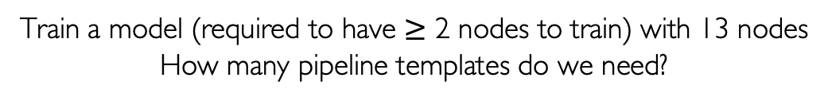
Issues in Using Pipeline Templates 1. Node Specification
No need to have a pipeline template for every possible # nodes
Train a model (required to have $≥$ 2 nodes to train) with 13 nodes
How many pipeline templates do we need?
Pipeline Template for 2 Nodes
Pipeline Template for 3 Nodes
Pipeline Template for 4 Nodes
Pipeline Template for 5 Nodes
Pipeline Template for 6 Nodes
Pipeline Template for 7 Nodes
Pipeline Template for 8 Nodes
Pipeline Template for 9 Nodes
Pipeline Template for 10 Nodes
Pipeline Template for 11 Nodes
Pipeline Template for 12 Nodes
Pipeline Template for 13 Nodes
Notes:
First, how many pipeline templates are actually needed?
It is of course possible to have pipeline templates for every possible number of nodes, (CLICK) for example if we train a model with 13 nodes, we can simply have pipeline templates for up to 13 nodes.
But it is very inefficient, considering we might want to use up to hundreds of nodes (CLICK) In fact, in this example of 13 nodes, only these three pipeline templates are enough
9:00

Slide 36
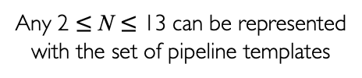
Issues in Using Pipeline Templates 1. Node Specification
Finding # templates & # nodes per template formulated as a Frobenius problem
Provable guarantee that a linear combination of the set of pipeline templates use all nodes even after failures
13 nodes
Pipeline Template A
(2 nodes)
Pipeline Template B
(3 nodes)
12 nodes
Pipeline Template C
(4 nodes)
11 nodes
3 Heterogeneous Pipeline Templates
Any 2 $≤$ N $≤$ 13 can be represented with the set of pipeline templates
Notes:
How Oobleck finds the number of pipeline templates and the number of nodes per pipeline template?
They are formulated as a Frobenius problem. Based on the formulation, it is provably guaranteed that a linear combination of the generated set of pipeline templates use all nodes.
The beauty of this formulation is that, they can cover not only the number of nodes at the beginning, (CLICK) which is 13 in our example,( CLICK) but also covers any number of nodes that is less than 13.
This guarantee enables that a pre-generated set of pipeline templates covers any failure situation no matter how many failures happen, without adding additional templates during runtime.
Details about formulation can be found in the paper.
9:50

Slide 37
Issues in Using Pipeline Templates 2. Pipeline Instantiation
Execution engine instantiates pipelines from pipeline templates that use all nodes
The plan is not unique
Set of pipeline templates
Pipeline Template A
(2 nodes)
x1
Pipeline Template B
(3 nodes)
x1
Pipeline Template C
(4 nodes)
x2
13 nodes
Notes:
After generating pipeline templates, pipelines are instantiated from them.
From the same example we used, the 13 nodes can be used (CLICK) to create 4 pipelines as in the right side of the screen.
(CLICK) However, this execution plan is not a unique example, and there might be more plans with the same set of pipeline templates and same number of nodes.
10:20

Slide 38
Issues in Using Pipeline Templates 2. Pipeline Instantiation
Use dynamic programming to enumerate all possible instantiation plans
Estimate iteration time of every plans and pick the best one
# instantiations per pipeline template
Total # nodes used
Plan 1
x1
x1
x2
13
Plan 2
x0
x3
x1
13
Plan 3
x5
x1
x0
13
more options
Notes:
We use dynamic programming to enumerate all possible plans.
For every possible plans, we estimate iteration time and pick the fastest one.
(CLICK) But here, estimating iteration time

Slide 39
2. Pipeline Instantiation Batch Distribution
Need to know batch size per pipeline to estimate iteration time
Formulate finding batch distribution that minimizes overall iteration time as an integer optimization problem
Plan 1
Minibatch
# Instantiations
Pipeline Templates
“Find batch size of each pipeline”
79
x1
Global batch
512
512
119
x1
157
x2
Total batch 512
Notes:
requires to know batch size per pipeline.
At this moment we only know the global batch size, but do not know how it should be distributed to the pipelines.
(CLICK) We formulate it as an integer optimization problem. (CLICK) The solver finds minibatch for each pipeline, where the sum of batch matches the given global batch, while minimizing overall iteration time of this plan.
11:00

Slide 40

2. Pipeline Instantiation Batch Distribution
Estimate iteration time of every plans and pick the best one
Plan 1
Minibatch
# Instantiations
Pipeline Templates
79
x1
Plan 2
Plan 3
119
x1
N/A
x0
79
x5
more
options
...
118
x3
117
x1
157
x2
158
x1
N/A
x0
Notes:
After calculating minibatch for pipelines and for every plans, (CLICK) we can estimate iteration time (CLICK) and can pick the fastest one.
11:15

Slide 41
Issues in Using Pipeline Templates 3. Pipeline Merge
Reinstantiate a new pipeline from another pipeline template when failures happen
Pipeline Template
(2 nodes)
Pipeline Template
(3 nodes)
Pipeline Template
(4 nodes)
13 → 11 nodes (2 nodes failed)
Notes:
Let’s recap how pipeline template is used when failures happen.
Assume we lost two nodes here. The first pipeline now has only two nodes. (CLICK) As we have a pipeline template for 2 nodes, (CLICK) we simply reinstantiate it and replace the old one.
(CLICK) Same reinstantiation happens in parallel to the second pipeline using pipeline template for 3 nodes.
11:45

Slide 42
Issues in Using Pipeline Templates 3. Pipeline Merge
When no feasible pipeline template: merge pipelines
Provable guarantee that Oobleck always has a template for merged pipeline
Merge pipelines
Total 3 nodes
Pipeline Template
(2 nodes)
Pipeline Template
(3 nodes)
Pipeline Template
(4 nodes)
8 → 7 nodes (1 node failed)
Notes:
As training goes on, there might not be feasible pipeline templates to be instantiated.
In this example, there is no pipeline template for just one node.
Instead of leaving it unused, (CLICK) we merge it with another pipeline, (CLICK) then we have 3 nodes so that pipeline template for 3 nodes can be instantiated.
(CLICK) Oobleck provably guarantees that there is always a feasible template when you merge pipelines.
12:20

Slide 43
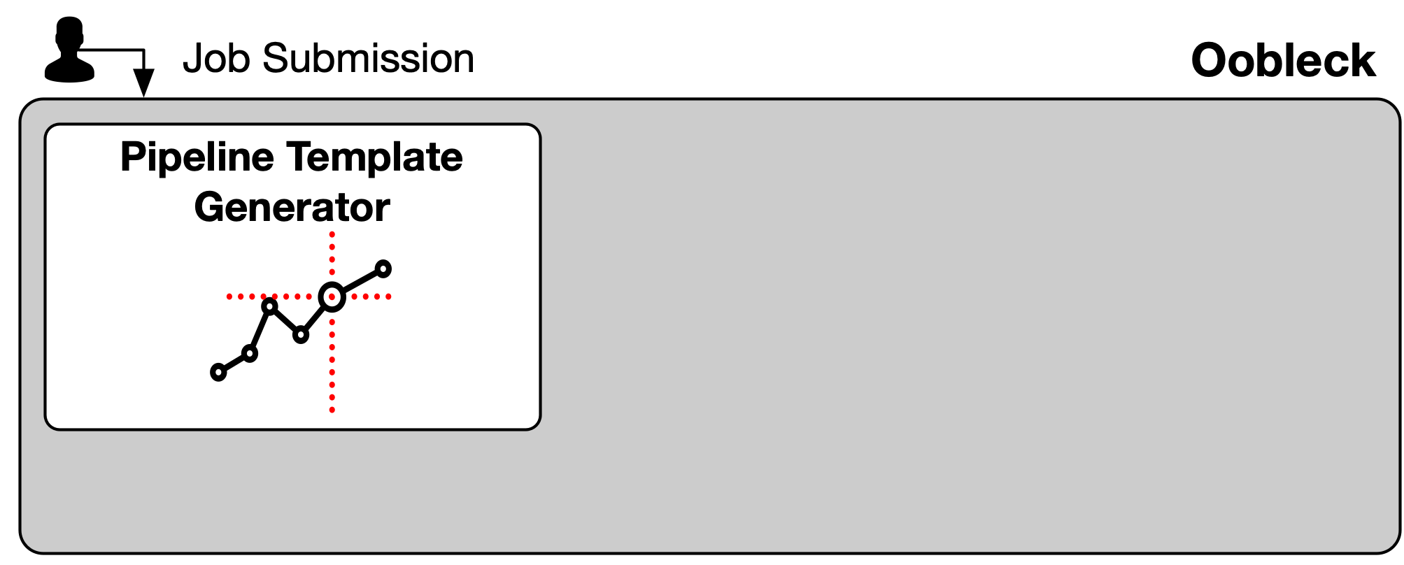
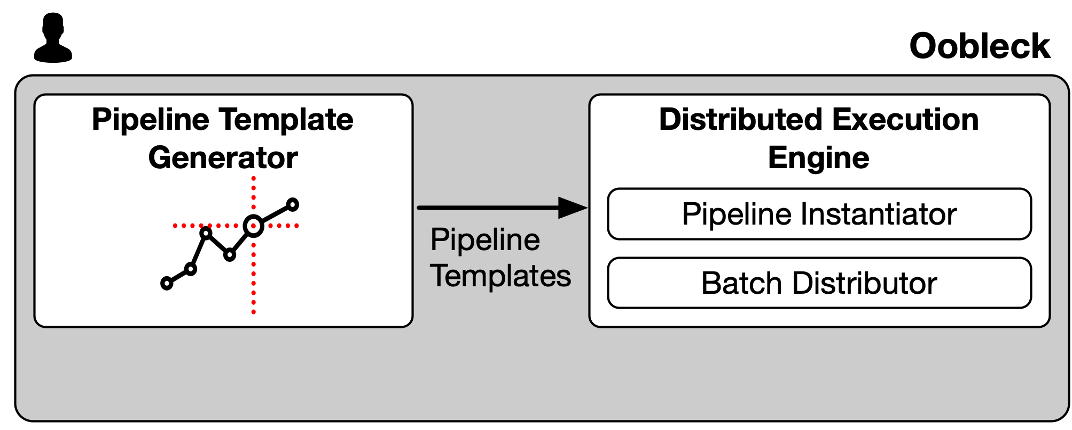
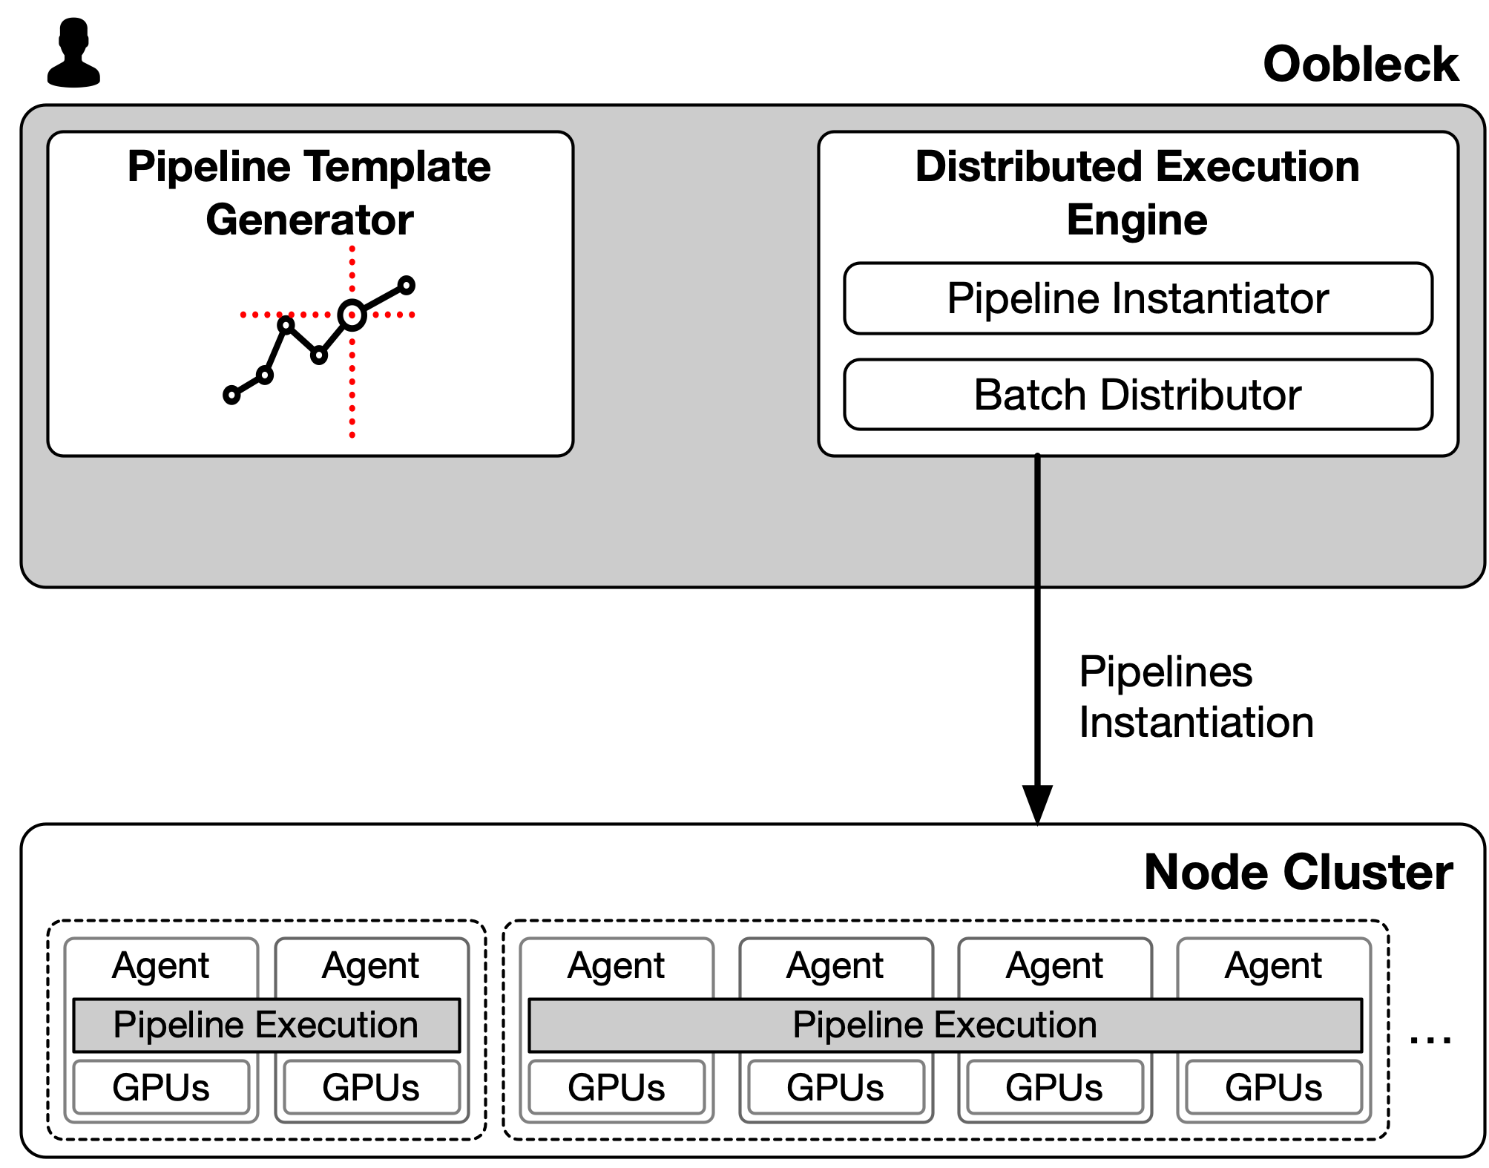
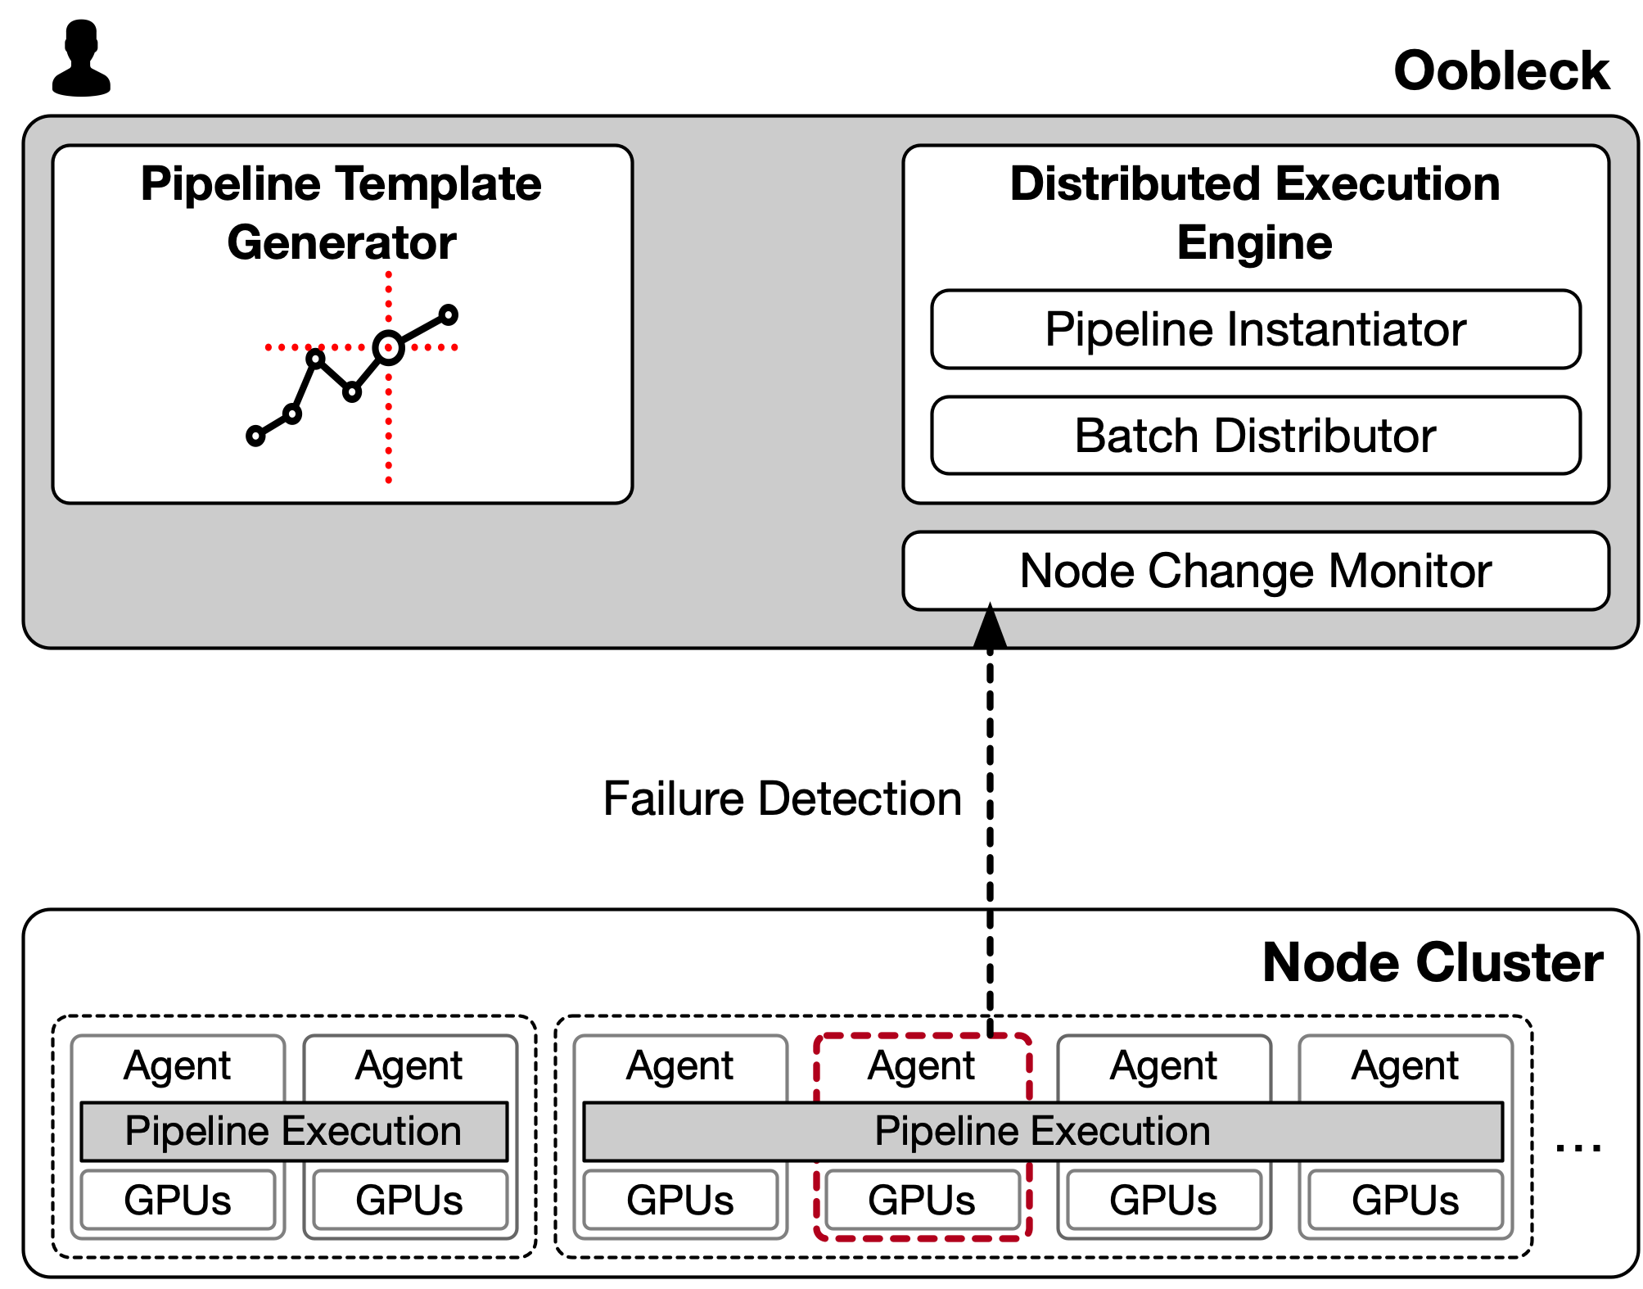
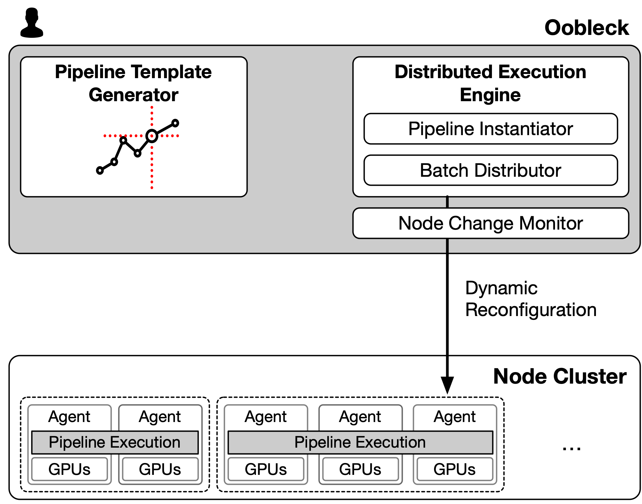
Oobleck Architecture Workflow
Generate pipeline templates
Instantiate pipelines from the pipeline templates
Pipeline reinstantiation when failures detected
Notes:
In overall architecture, we first generate a set of pipeline templates,.
(CLICK) Given the generated pipeline templates, distributed execution engine instantiates actual pipelines from the pipeline template (CLICK) and deploy them to the node cluster.
Note that once a set of pipeline template is generated, the set is never changed, and used for the entire training.
(CLICK) When failures happen, the engine reinstantiates the affected pipelines without full restart. (CLICK) After pipeline reinstantiation, the cluster can continue training.
13:00

Slide 44
Limitations & Discussion
Oobleck only tolerates node-granularity hardware failures
Slowing down in computational resources or network bandwidth is not covered
Supporting heterogeneous GPUs/network can be a part of this problem
Pipeline 1
Pipeline 1
Pipeline 2
Pipeline 2
Pipeline 3
Pipeline 3

Slide 45
Evaluation
Setup
Compare Bamboo, Varuna, and Oobleck
30 NVIDIA A40 GPUs with 200Gbps Infiniband
Various size of models from BERT-Large (345M) to GPT-3 6.7b (6.7B)
Questions
How much is Oobleck better than SOTAs (Bamboo and Varuna)?
Why Oobleck is better?
Notes:
We evaluated and compared Bamboo, Varuna, and Oobleck using 30 NVIDIA A40 GPUs and Infiniband.
We used various size of models. In this talk, we will show you BERT-large as a small model, and GPT-3 6.7b as a large model.
More details about training setup are in the paper.
(CLICK) We first present overall training throughput in those frameworks to see how much Oobleck is better, and then why it is better through breakdown analysis.
13:30

Slide 46
Small Model Throughput
BERT-Large
400
Bamboo
Varuna
300
Oobleck
Throughput (samples/second)
200
100
Throughput
Average
0
0
6
12
Time (hours)
Numbers in Bamboo EC2 p3 spot instance traces.
Notes:
Let’s start from small model throughput changes over time.
We used Bamboo’s spot instance traces and simulator to simulate throughput change for all three frameworks.
x-axis is time. After initially getting 30 spot GPUs, it may be preempted or readded over time. We have the graph of GPU availability over time in the paper. Horizontal dotted line is an average for the entire time.
(CLICK) Varuna matches Oobleck for small models. It is expected as checkppointing and reconfiguration overheads for small models are not that big.
(CLICK), For Bamboo, it is overall slow compared to both Varuna and Oobleck.
14:20

Slide 47
Large Model Throughput
Failed to train due to its design (OoM)
GPT-3 6.7b
6
Bamboo
Varuna
Failed to train due to high restart overheads
4
Oobleck
Throughput (samples/second)
2
Throughput
Average
0
0
6
12
Time (hours)
Numbers in Bamboo EC2 p3 spot instance traces.
Notes:
If model is larger, however, Oobleck outperforms both of the works.
For GPT-3 6.7b model, both Varuna and Bamboo can’t train the model.
(CLICK) Bamboo needs so much amount of memory for redundant computation, raising out of memory error even with the smallest microbatch.
(CLICK) For Varuna, it uses all of its time for reconfiguration, fully restarting the entire cluster and loading the checkpoint from the remote storage.
14:50

Slide 48
Throughput vs Bamboo
Model: BERT-Large
Low Failure Frequency
High Failure Frequency
100
100
100%
96%
Time Occupation (%)
Time Occupation (%)
50
50
20%
15%
0
0
Bamboo
Oobleck
Bamboo
Oobleck
80%
Computation overheads for redundancy
61%
Effective Time
Numbers in failiure-controlled environment.
Notes:
Let’s see why performance is that different, comparing Oobleck with each of the work.
Effective time here is the portion of time that is used for actual training.
This breakdown analysis is done under controlled environment where failures are manually injected periodically.
(CLICK) As expected, most of Bamboo’s time is wasted due to redundant computation.
The overheads dominates even in low failure frequency, since they speculatively execute redundant computation even there is no failure.
15:30

Slide 49
Throughput vs Varuna
BERT-Large
GPT-3 6.7b
100
100
94%
100%
99%
Low Failure Frequency
Time Occupation (%)
Time Occupation (%)
82%
50
50
0
0
Varuna
Oobleck
Varuna
Oobleck
Effective Time
Numbers in failiure-controlled environment.
Notes:
Now let’s compare with Varuna.
Varuna is optimized for low failure frequency without computation overheads in runtime.
They are comparable to Oobleck, but throughput is slightly less due to various overheads including checkpointing.
15:50

Slide 50
Throughput vs Varuna
BERT-Large
GPT-3 6.7b
100
100
94%
100%
99%
Low Failure Frequency
82%
Time Occupation (%)
Time Occupation (%)
50
50
0
0
Varuna
Oobleck
Varuna
Oobleck
-30%
-90%
100
100
High Failure Frequency
96%
Time Occupation (%)
Time Occupation (%)
76%
50
66%
50
6%
0
0
Varuna
Oobleck
Varuna
Oobleck
Effective Time
Numbers in failiure-controlled environment.
Notes:
When failures happen more frequently, however, its throughput suddenly drops as we saw in the end to end throughput graph.
(CLICK) this throughput drop is worse when model is larger. While for small model throughput drop is about 30%, Varuna lost 90% of its effective time of large model due to higher failure frequency.
(CLICK) When we zoom in GPT-3 high failure frequency graph, (CLICK)

Slide 51
Throughput vs Varuna
GPT-3 6.7b + High Failure Frequency
21%
100
67%
76%
Time Occupation (%)
50
GPT-3 6.7b vs GPT-3 175b?
30 GPUs vs 1024 GPUs?
6%
0
Varuna
Oobleck
Effective Time
Reconfiguration
Fallbacks
Numbers in failiure-controlled environment.
Notes:
(CLICK) We found reconfiguration is dominating, occupying nearly 70% of the entire time of Varuna, used just for restarting the cluster and loading checkpoint.
21% is further wasted by fallbacks, the iteration time that Varuna successfully finished but lost as they are not checkpointed.
(CLICK) Because the reconfiguration overheads will be much higher when either model is larger or failure happens more frequently, Varuna might not be able to train larger model in larger cluster.
16:50

Slide 52
Fault tolerance guarantee
Utilize model replicas as redundancy
Oobleck
https://github.com/SymbioticLab/Oobleck
insujang@umich.edu
High throughput
Utilize all available resources
Avoid stragglers in heterogeneous pipeline execution
Fast recovery from failures
Dynamic reconfiguration without restart
Reuse pre-generated pipeline templates
Notes:
In conclusion, Oobleck is the first resilient distributed training framework that provides rigorous fault tolerance guarantee, high throughput, and fast recovery simultanouesly.
Thank you for the attention.
17:00

Slide 53
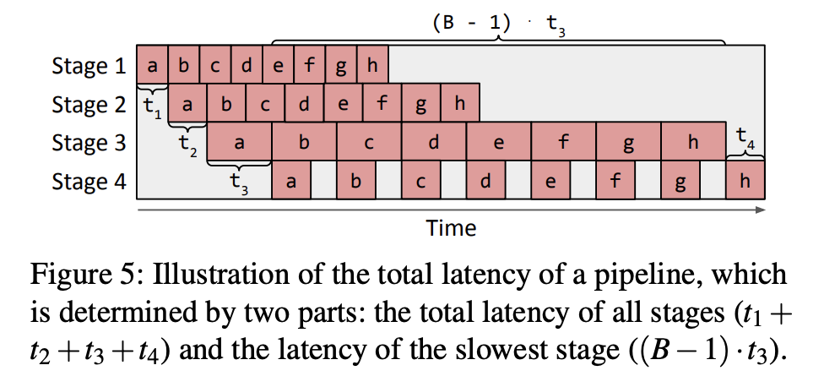
Pipeline Parallelism

Slide 54
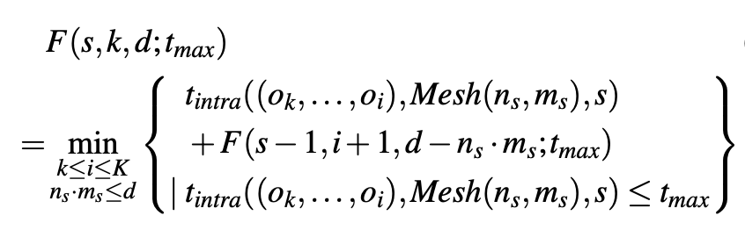
Dynamic Programming
Minimal total iteration time when slicing k-th~last operators into s stages and putting them to d devices
Time for one stage with kth~ith operators with s devices

Slide 55
Dynamic Programming
Minimal total iteration time when slicing k-th~last operators into s stages and putting them to d devices
Time for one stage with kth~ith operators with s devices
Iteration start: i=k
k-th
k1
k2
w1
w2
x
conv
relu
conv
add
avgpool
matmul
relu
matmul
softmax
One stage with n_{s}*m_{s} mesh
(i+1)-th-last operators in s-1 stages using d-n_{s}*m_{s} devices

Slide 56
Dynamic Programming
Minimal total iteration time when slicing k-th~last operators into s stages and putting them to d devices
Time for one stage with kth~ith operators with s devices
Iteration continues: i=k+1
k-th
k1
k2
w1
w2
x
conv
relu
conv
add
avgpool
matmul
relu
matmul
softmax
One stage with n_{s}*m_{s} mesh
(i+1)-th-last operators in s-1 stages using d-n_{s}*m_{s} devices

